Slide 1
DATA SCIENCE
Week 6 - Decision Trees

Slide 2
AGENDA
What are decision trees?
How decision trees work
Visual example
Lab
Discussion

Slide 3
DECISION TREES
DATA SCIENCE PART TIME COURSE

Slide 4
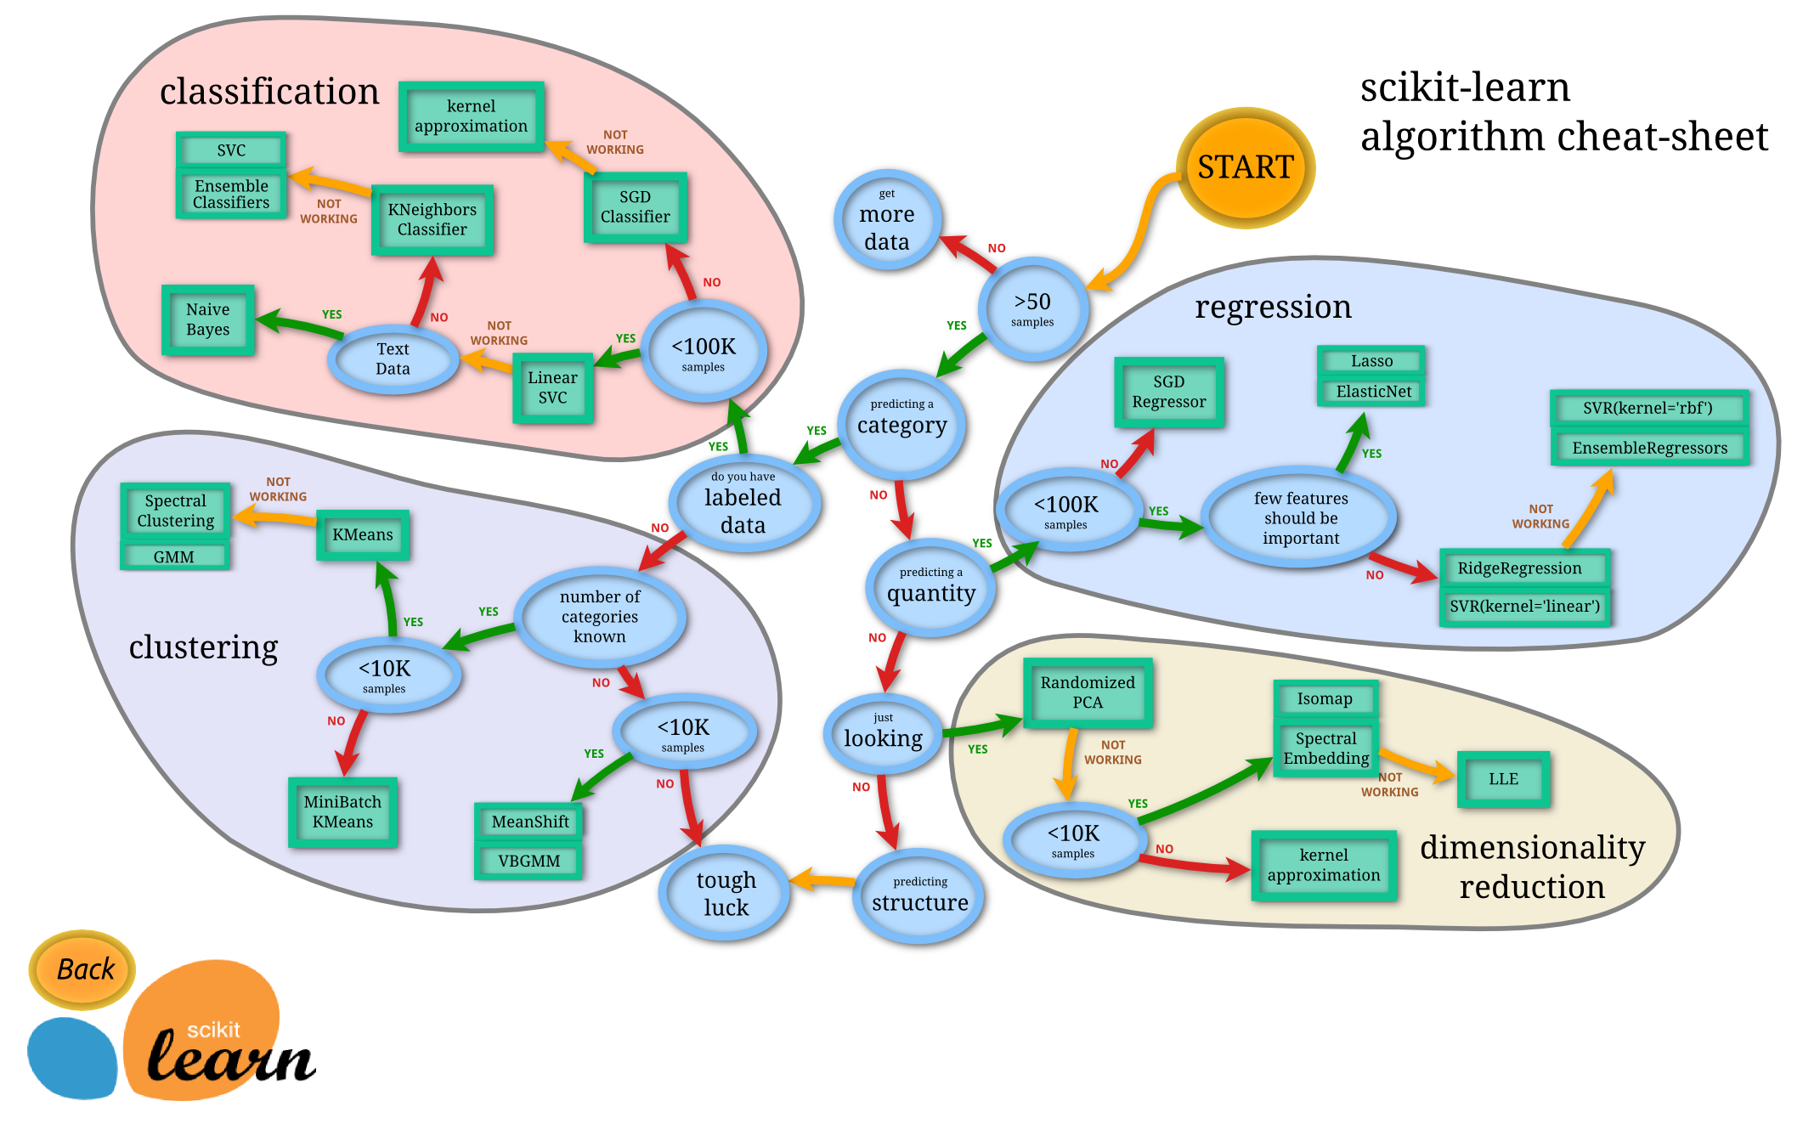

Slide 5
WHAT ARE DECISION TREES?
A supervised learning technique that can be used for classification or regression.

Slide 6
WHAT ARE DECISION TREES?
A supervised learning technique that can be used for classification or regression.
Visually engaging and easy to interpret.

Slide 7
WHAT ARE DECISION TREES?
Supervised learning technique
Used for classification or regression.
Visually engaging and easy to interpret.
Foundation for getting into very powerful techniques.

Slide 8
DECISION TREES - SHORTCOMINGS
Prone to overfitting.

Slide 9
DECISION TREES - SHORTCOMINGS
Prone to overfitting.
Predictive power is lower in comparison to many other modern techniques.

Slide 10
DECISION TREES - HOW IT WORKS
Scans for a feature to split on that results in the greatest separation between classes in the resulting nodes.

Slide 11
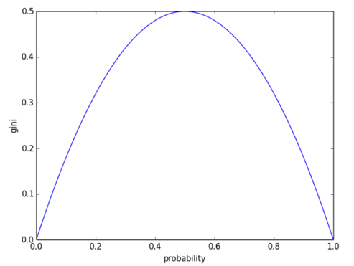
DECISION TREES - HOW IT WORKS
The Gini Index
Equal ratio of target classes
50:50
High purity
of class 0
High purity
of class 1

Slide 12
DECISION TREES - HOW IT WORKS
Scans for a feature to split on that results in the greatest separation between classes in the resulting nodes.
Non-linear.

Slide 13
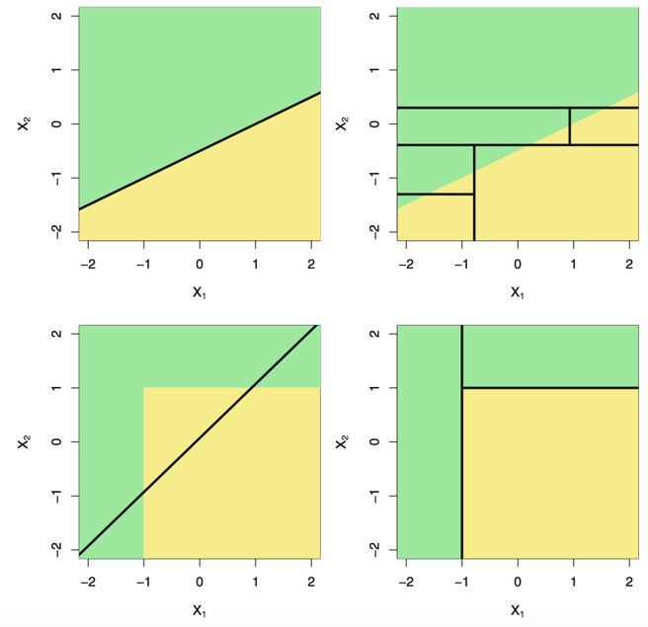
DECISION TREES - HOW IT WORKS
Linear decision boundary
Non-linear decision boundary

Slide 14

DECISION TREES - HOW IT WORKS
Scans for a feature to split on that results in the greatest separation between classes in the resulting nodes.
Non-linear
Greedy process
Splits within splits

Slide 15
DECISION TREES - HOW IT WORKS
Scans for a feature to split on that results in the greatest separation between classes in the resulting nodes.
Non-linear
Greedy process
Splits within splits
Predict each observation belongs to the most commonly occurring class in the region to which it belongs.

Slide 16
DECISION TREES - HOW IT WORKS
Scans for a feature to split on that results in the greatest separation between classes in the resulting nodes.
Non-linear
Greedy process
Splits within splits
For a classification tree, we predict that each observation belongs to the most commonly occurring class of training observations in the region to which it belongs.
We naturally get combinations of features used for our prediction.

Slide 17
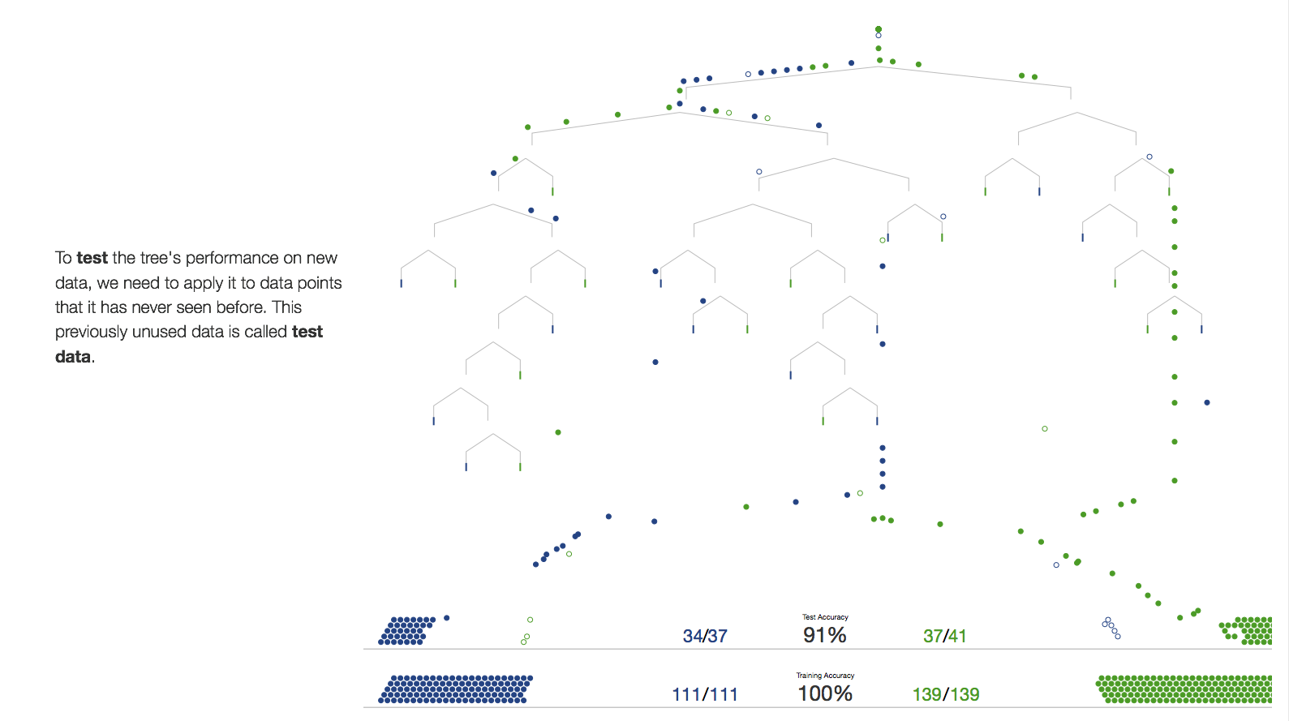
VISUALISING A DECISION TREE FIT
http://www.r2d3.us/visual-intro-to-machine-learning-part-1/

Slide 18
More Detail
DATA SCIENCE PART TIME COURSE

Slide 19

Nonlinear Classification
Decision Trees
split categorical variables using feature-based decision boundaries e.g.
reply = yes ?
colour = green ?
split continuous variables using decision boundaries based on some criterion e.g.
x < 5 ?
(x00ff00 & rgb) ?
goal: predict class membership for target variable
N rows
M columns
(test)_{i}
True
False
N_{i} rows
M columns
(N_{i} − 1) rows
M columns

Slide 20
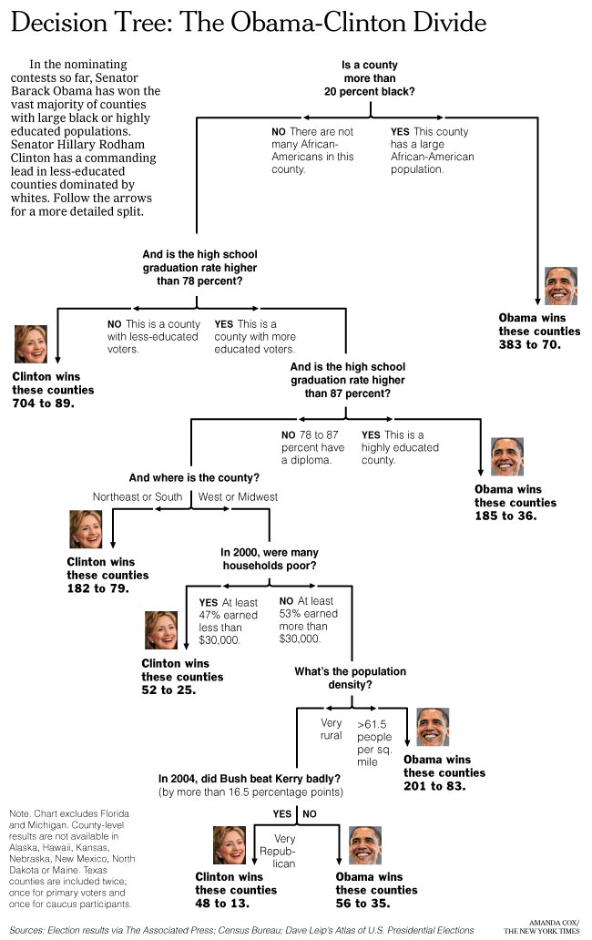
Decision Trees
like the game 20 Questions: make a decision by answering a series of questions, most often binary (yes | no)
prefer the smallest set of questions that delivers the right answer
each question should reduce the search space as much as possible

Slide 21
Building a Decision Tree
a tree is a data structure made up of nodes and branches
each node typically has two or more branches that connect it to its children
Node
Branch
Branch
Child
Node
Child
Node

Slide 22
Building a Decision Tree
each child is another node in the tree and contains its own subtree
a child node with its own children is also a parent node
nodes with no children are known as leaf nodes
the number of levels between the top-most parent and the bottom-most leaf is the depth of the tree
Parent
Node
Child/Parent
Node
Leaf
Node
Leaf
Node
Leaf
Node

Slide 23
Building a Decision Tree
Test
each parent node in the tree contains a test that splits the data into two child nodes
each test implies that samples which pass belong to a particular class
true results go down the left branch and false down the right
parent nodes contain a mixture of correct and incorrect classifications … Why?
True
False
Leaf
Node
Test
True
False
Leaf
Node
Test
True
False
Leaf
Node
Leaf
Node

Slide 24
Building a Decision Tree
each test assumes that samples which pass (true results) belong to a particular class
samples which fail the test (false results) are assumed to belong to a different class
a child test may reverse a previously rejected class membership
when tree-building is complete, the leaf nodes contain the predictions
Demo: http://www.r2d3.us/visual-intro-to-machine-learning-part-1/
Test
True
False
Leaf
Node
Test
True
False
Leaf
Node
Test
True
False
Leaf
Node
Leaf
Node

Slide 25
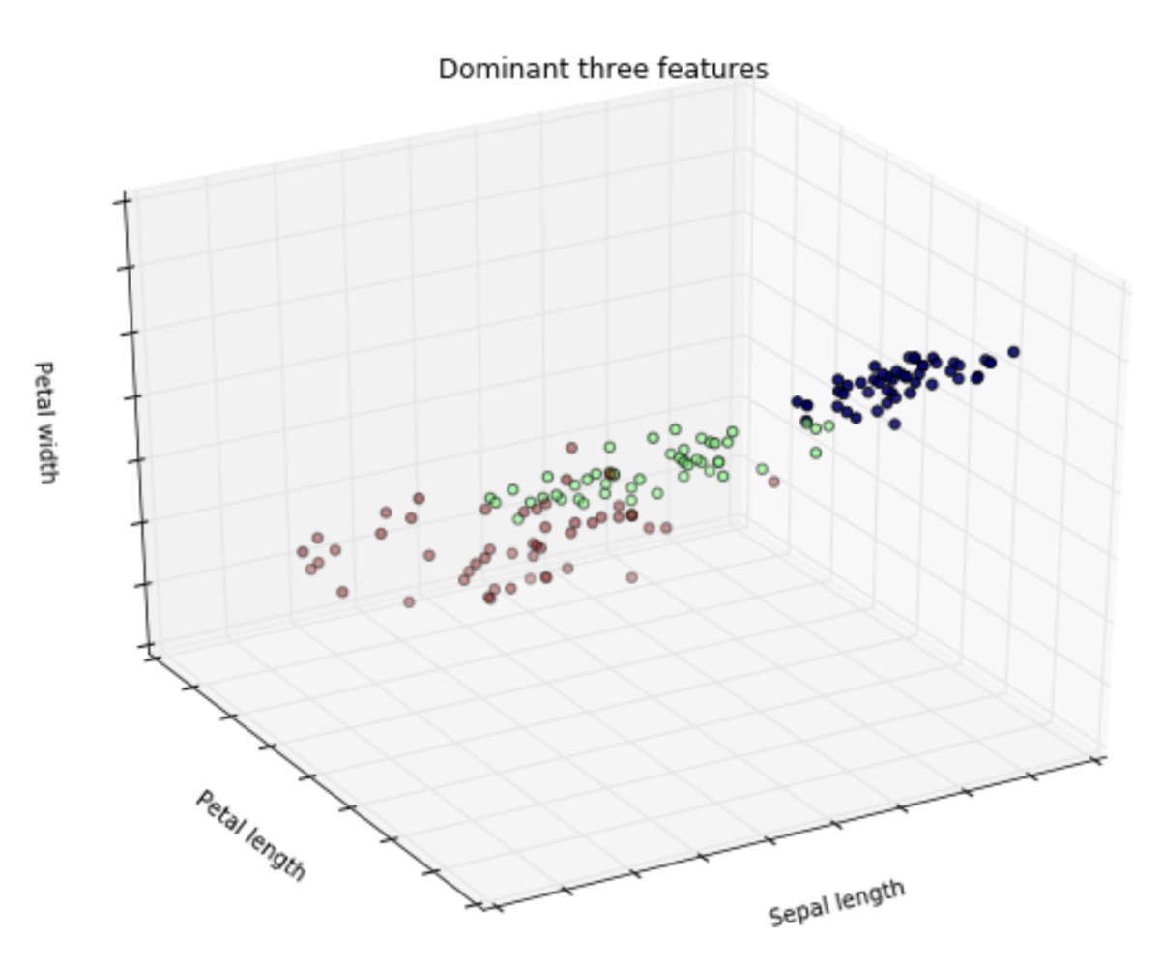
Group Exercise
Using the iris dataset, design a simple decision tree for classifying the samples by species
Implement the tests in Python and see how well they split the data
Don’t go beyond a depth of 4
4 groups 20 minutes
target variable
species (3 classes)
columns:
sepal length
sepal width
petal length
petal width
class (3)
rows:
50 x 3
https://archive.ics.uci.edu/ml/machine-learning-databases/iris/iris.data

Slide 26
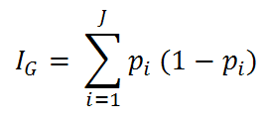
Building a Decision Tree: How to choose a split?
Gini impurity
gini impurity of a node
p_{i} = probability of choosing a sample from class i (i.e. the proportion of the node that is class i)
(1 − p_{i}) = the probability that the sample’s classification is an error
a pure node (contains only one class) has I_{G} = 0
used by the CART (classification and regression tree) algorithm
<= Minimise Ig

Slide 27
Building a Decision Tree: How to choose a split?
Classification Error
accuracy, precision, recall
Variance reduction
used where target variable is continuous (regression tree)
Information Gain
information gain is modelled as a decrease in entropy (mixing of classes) before and after a split
used by the ID3, C4.5, C5.0 algorithms

Slide 28
Building a Decision Tree: When to Stop?
nothing left to split on
all leaves are pure (contain only one class)
or, all possible splits have been tried
maximum tree depth reached
typically, we want to limit branch length, to avoid complexity

Slide 29
Decisions Tree in Python
sklearn.tree
DecisionTreeClassifier() train
export_graphviz() plot tree
predict() predict classes
predict_proba() predict class probabilities

Slide 30
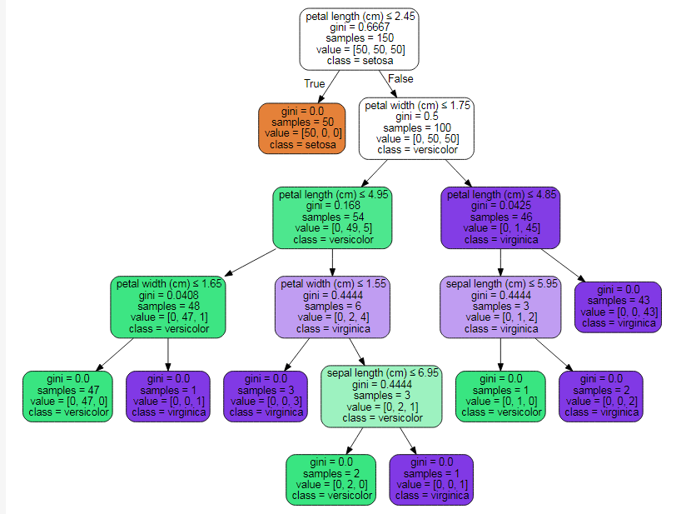
Iris Dataset
test
gini index of node
number of samples in node
class membership in node [setosa, versicolor, virginica]
target class of test
http://scikit-learn.org/stable/modules/tree.html

Slide 31
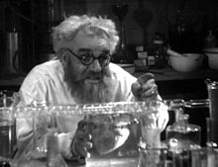
Lab 11a: Decision Trees
with DecisionTreeClassifier

Slide 32
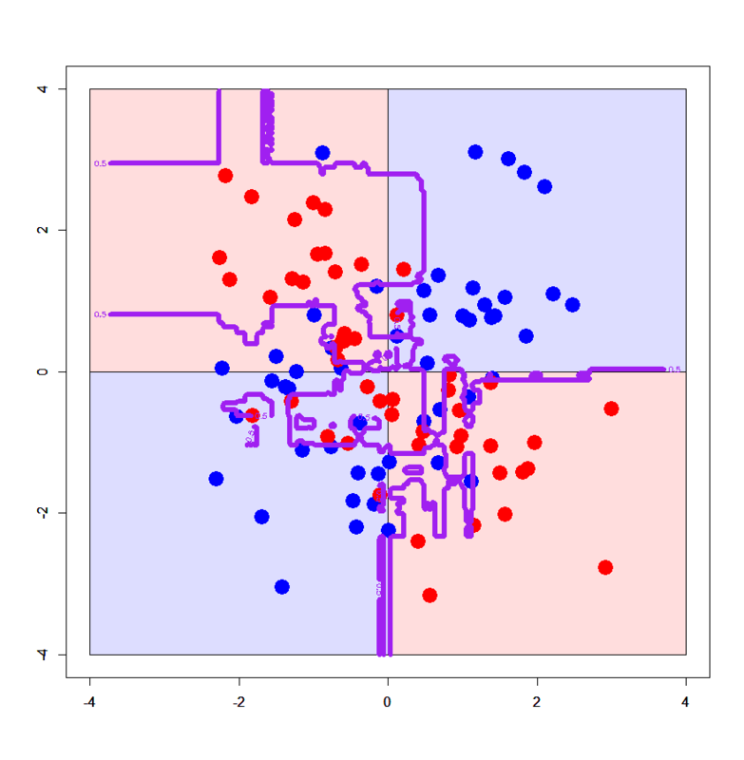
What About Over-fitting?
decision trees tend to be weak models because they can easily overfit a dataset
overfitting occurs when a model memorises the data or bends to a few specific data points rather than picking up general trends in the data
small variations in the data might result in the generation of a completely different tree
an unconstrained model could build an extreme tree
e.g. one feature for each word in a news article

Slide 33
What About Over-fitting?
We can limit our decision trees using a few methods:
limit the number of questions (nodes) a tree can have
limit the tree depth
set the minimum number of samples required at a leaf node
accept a specified level of impurity in the leaf nodes
by trial & error:
specify a conservative limit maximum tree depth
evaluate training error
use pruning:
allow all branches to grow until no further information gain achieved
prune branches (i.e. eliminate leaf nodes) until an acceptable leaf purity is just achieved (or some global criterion)

Slide 34

Divider Slide Title
Could we use a decision tree for regression?
What is regression, again?

Slide 35
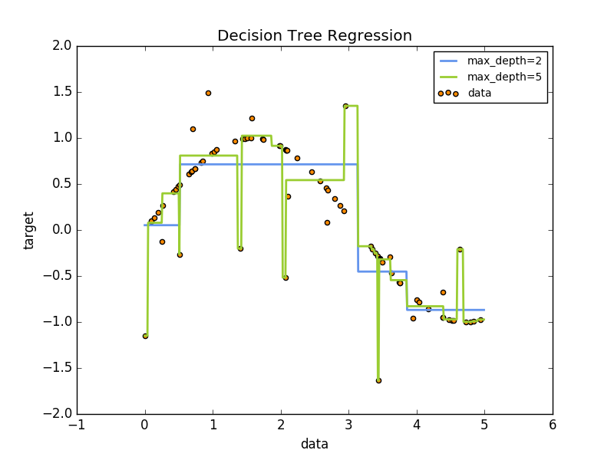
Decision Trees for Regression
example: 1D regression of a noisy sine wave
http://scikit-learn.org/stable/auto_examples/tree/plot_tree_regression.html

Slide 36
Pros & Cons of Decision Trees
Pros | Cons
nonlinear | overfitting
can tolerate interacting variables | can be more susceptible to outliers, labelling error limited predictive power
produces sensible rules easy to interpret (if depth not too great) visually engaging | can produce complex rules
non-parametric | do not reveal (mathematical) relationships

Slide 37
Additional Resources
Scikit-learn decision trees tutorial
http://scikit-learn.org/stable/modules/tree.html
sklearn.tree.DecisionTreeClassifier
http://scikit-learn.org/stable/modules/generated/sklearn.tree.DecisionTreeClassifier.html#examples-using-sklearn-tree-decisiontreeclassifier

Slide 38

Lab 11b: Decision Trees
Build a decision tree for predicting survival using the Titanic Data Set !

Slide 39
Python Environment
You will find files to build a common environment here:
/dat10syd/env/ananconda_spec_file.txt
/dat10syd/env/pip_requirements.txt
To create the new Anaconda environment:
In Anaconda navigator go to “Environments” on the left sidebar
Click “New” or the “+” sign at the bottom of the pane
Give the environment a name e.g. “dat10syd_env”
Select Python 3.6
Select /dat10syd/env/ananconda_spec_file.txt
Click “Create”
Once the env is created, right click on it and click “terminal”
type pip3 install -r /dat10syd/env/pip_requirements.txt
Volunteer to set this up on Windows and share the pip freeze file?

Slide 40

SYNCHING YOUR FORK WITH THE COURSE REPO
re-name your labs with lab_name.<yourname>.ipynb (to prevent a conflict)
cd <path to the root of your DAT10SYD local repo>
commit your changes ahead of sync
git status
git add .
git commit -m “descriptive label for the commit”
git status
download new material from official course repo (upstream) and merge it
git checkout master (ensures you are in the master branch)
git fetch upstream
git merge upstream/master

Slide 41
DATA SCIENCE - Week 6
DISCUSSION TIME
Review of last week
Further Reading for Decision Trees
Check in with homework/course project
Pre-Reading

Slide 42
WEEK 5 Review
DISCUSSION TIME
Recommendations
SQL & Productivity Tools
Linear Regression

Slide 43

DISCUSSION TIME
DATA SCIENCE - Week 6 Day 1
CIA using Decision Trees
https://www.cia.gov/library/center-for-the-study-of-intelligence/kent-csi/vol18no4/html/v18i4a03p_0001.htm
Overview of difference approaches to building models
https://www.amazon.com/Master-Algorithm-Ultimate-Learning-Machine/dp/0465065708

Slide 44
PRE-READING
An Introduction to Statistical Learning
Chapter 8 - Tree-Based Methods or
(https://youtu.be/QHOazyP-YlM) & (https://www.youtube.com/watch?v=sRktKszFmSk)
Signup to Google Cloud Platform
https://cloud.google.com/
DATA SCIENCE - Week 6 Day 1

Slide 45
Final Project
FINAL PROJECT
Complete Project 1 for Tues 12th Dec 2017
Complete Project 2 for Tues 19th Dec 2017
Complete Project 3 for Tues 9th Jan 2018 <= NEXT TUESDAY
Complete Project 4 for Tues 16th Jan 2018
Complete Project 5 for Tues 23th Jan 2018
Deliver Final Project Tues 30th Jan 2018

Slide 46
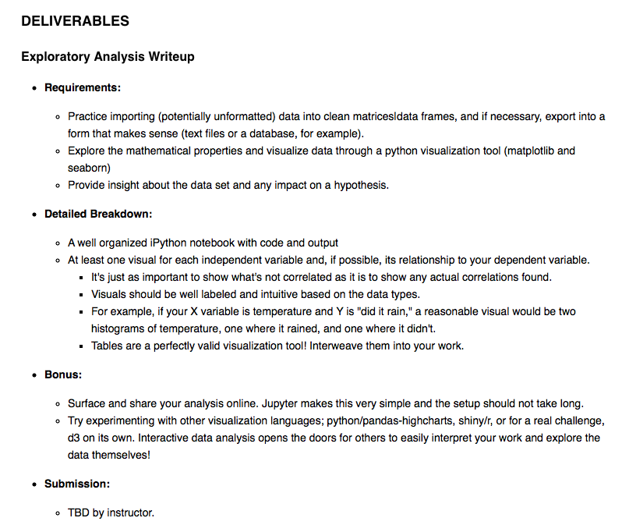
Final Project

